Slide 1
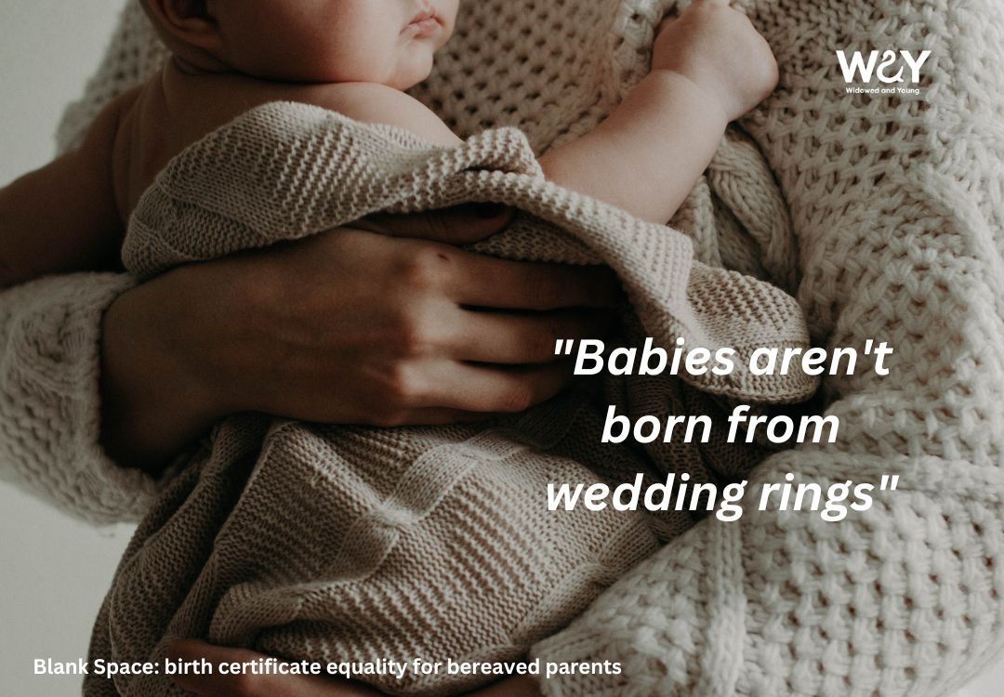

^{Blank Space:}
^{Birth Certificate equality for}
^{co-habiting bereaved parents}
^{15th April 2025}
Registered Charity
No: 1164988

Slide 2
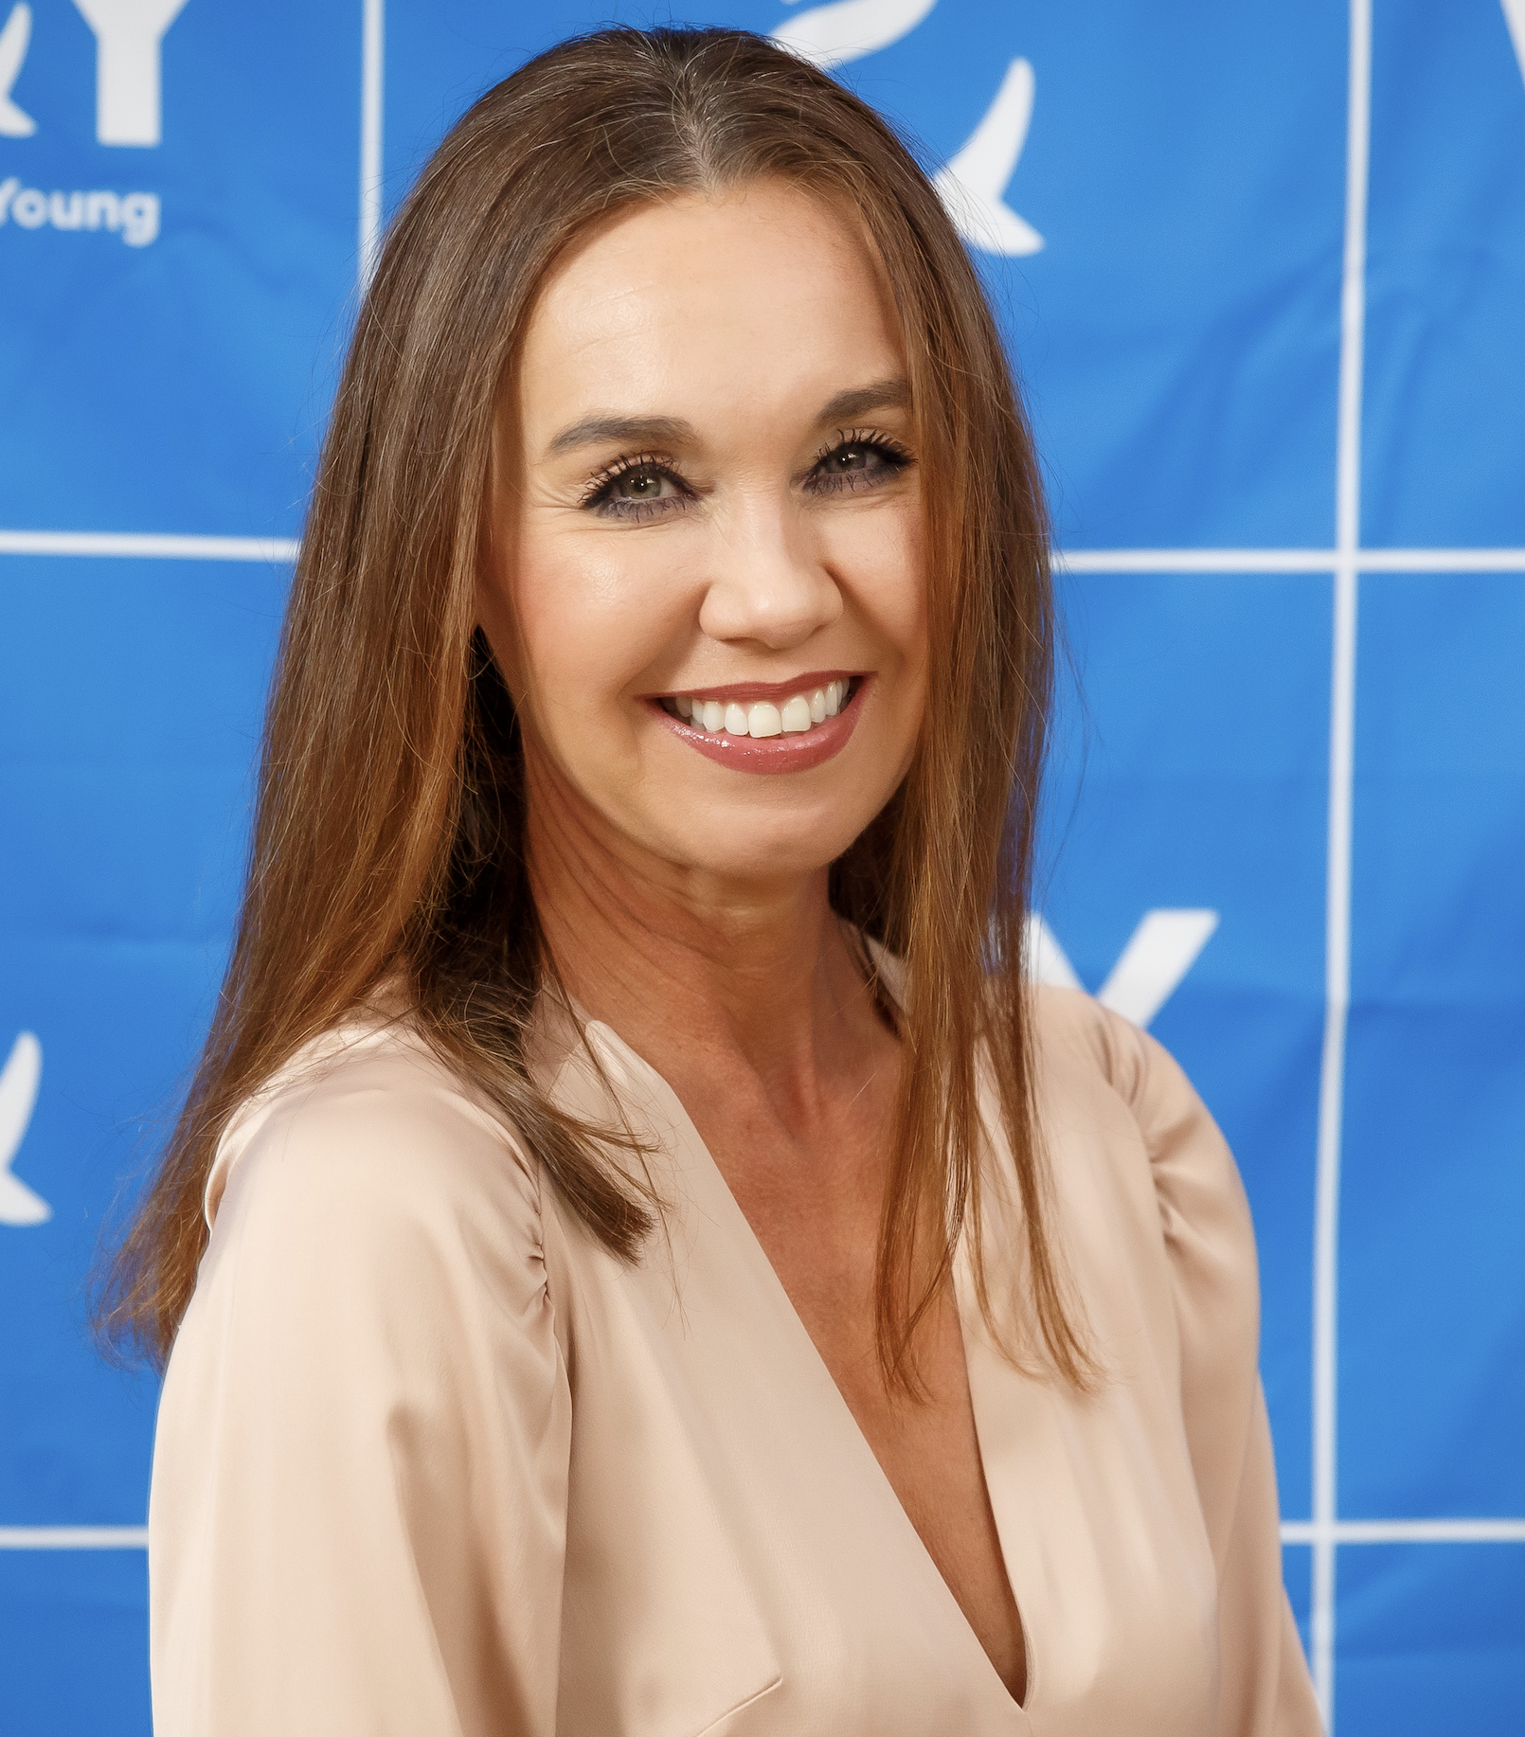
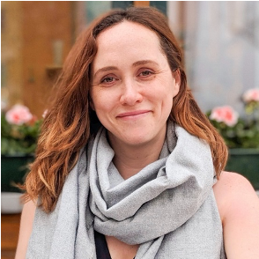
Welcome and Introductions
Stephanie Patrick
Chief Executive
WAY Widowed and Young
stephanie.patrick@widowedandyoung.org.uk
Orlanda Bryars
Blank Space Campaign Ambassador
WAY Widowed and Young
Registered Charity
No: 1164988

Slide 3
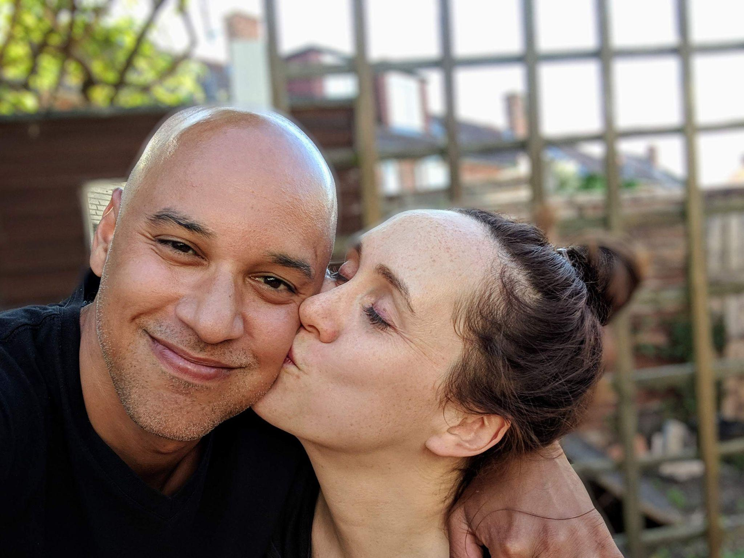
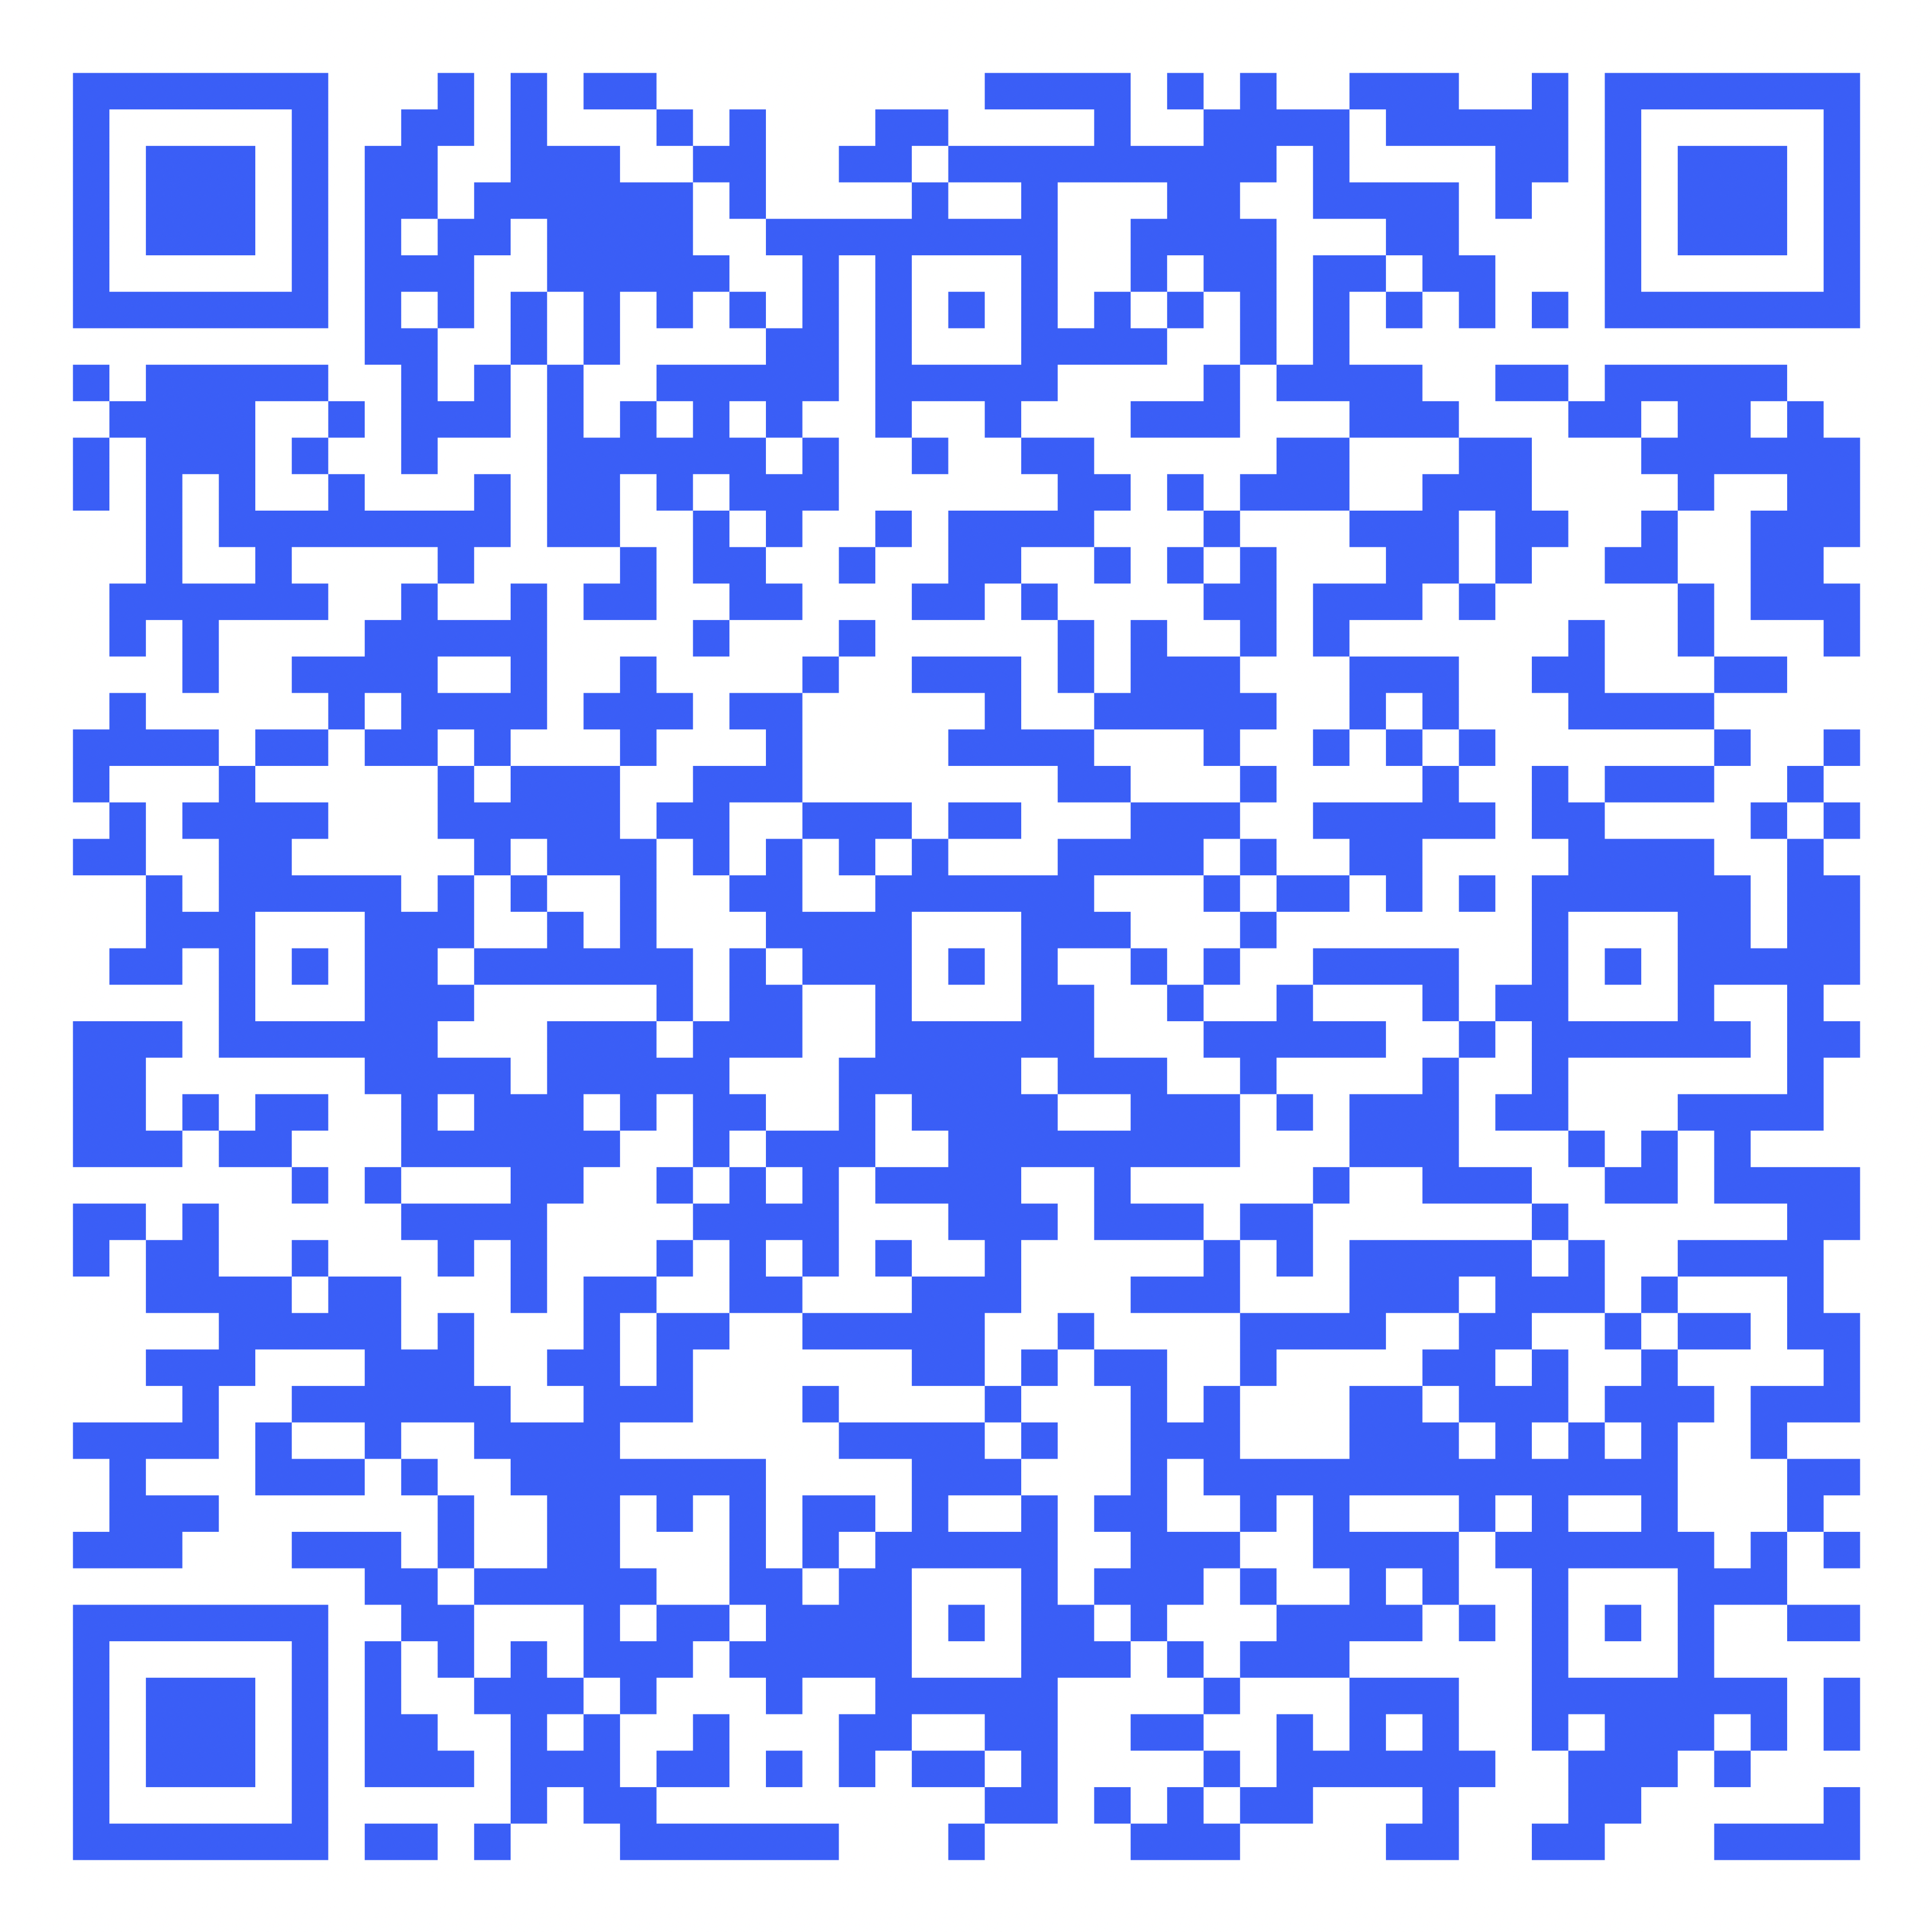
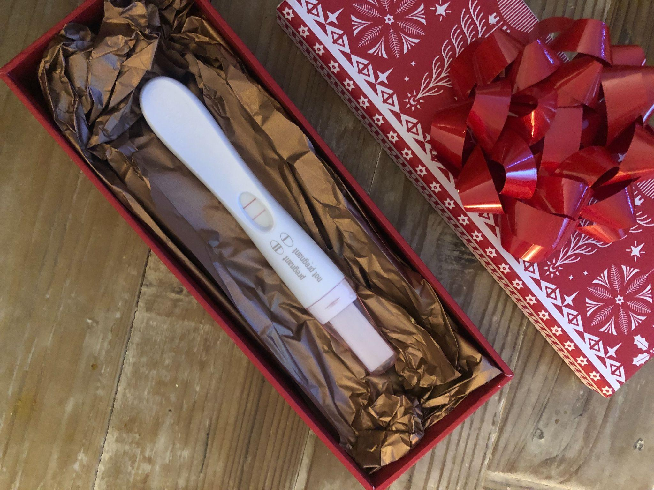
Orlanda and Julian’s Story
Registered Charity
No: 1164988

Slide 4
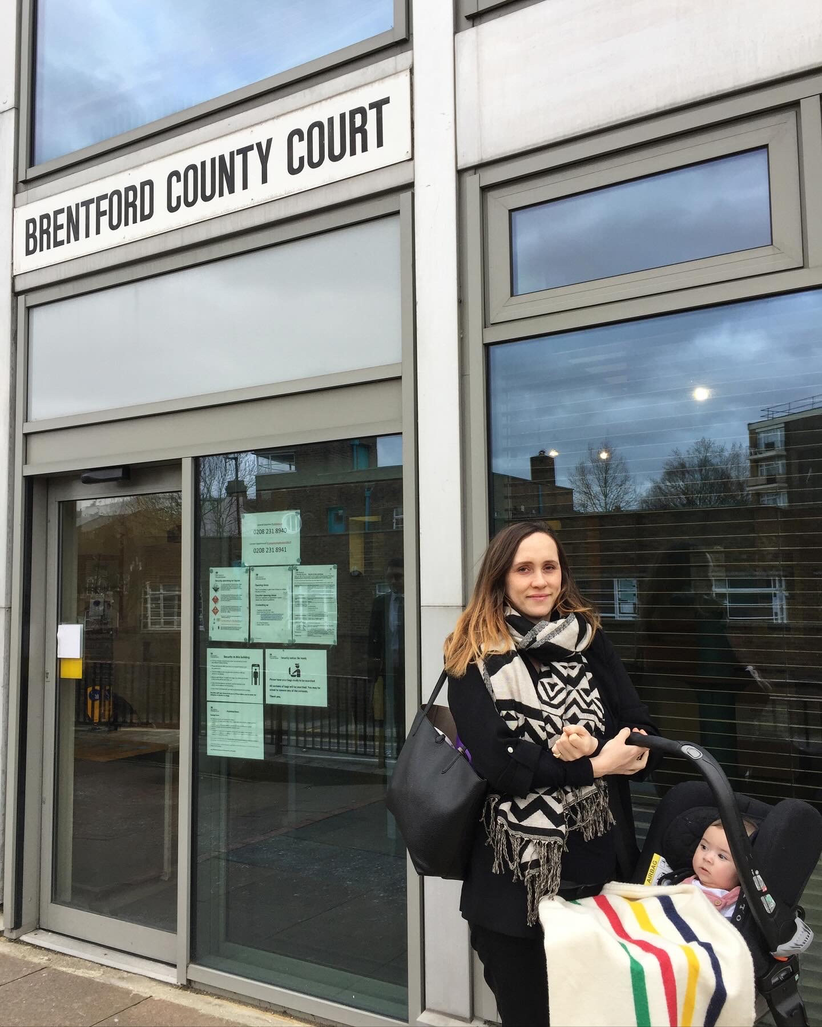
Orlanda and Julian’s Story
“Women whose partners have died during pregnancy should have a clear and simple process to be able to have their partners named on their child’s birth certificate”.
Registered Charity
No: 1164988

Slide 5
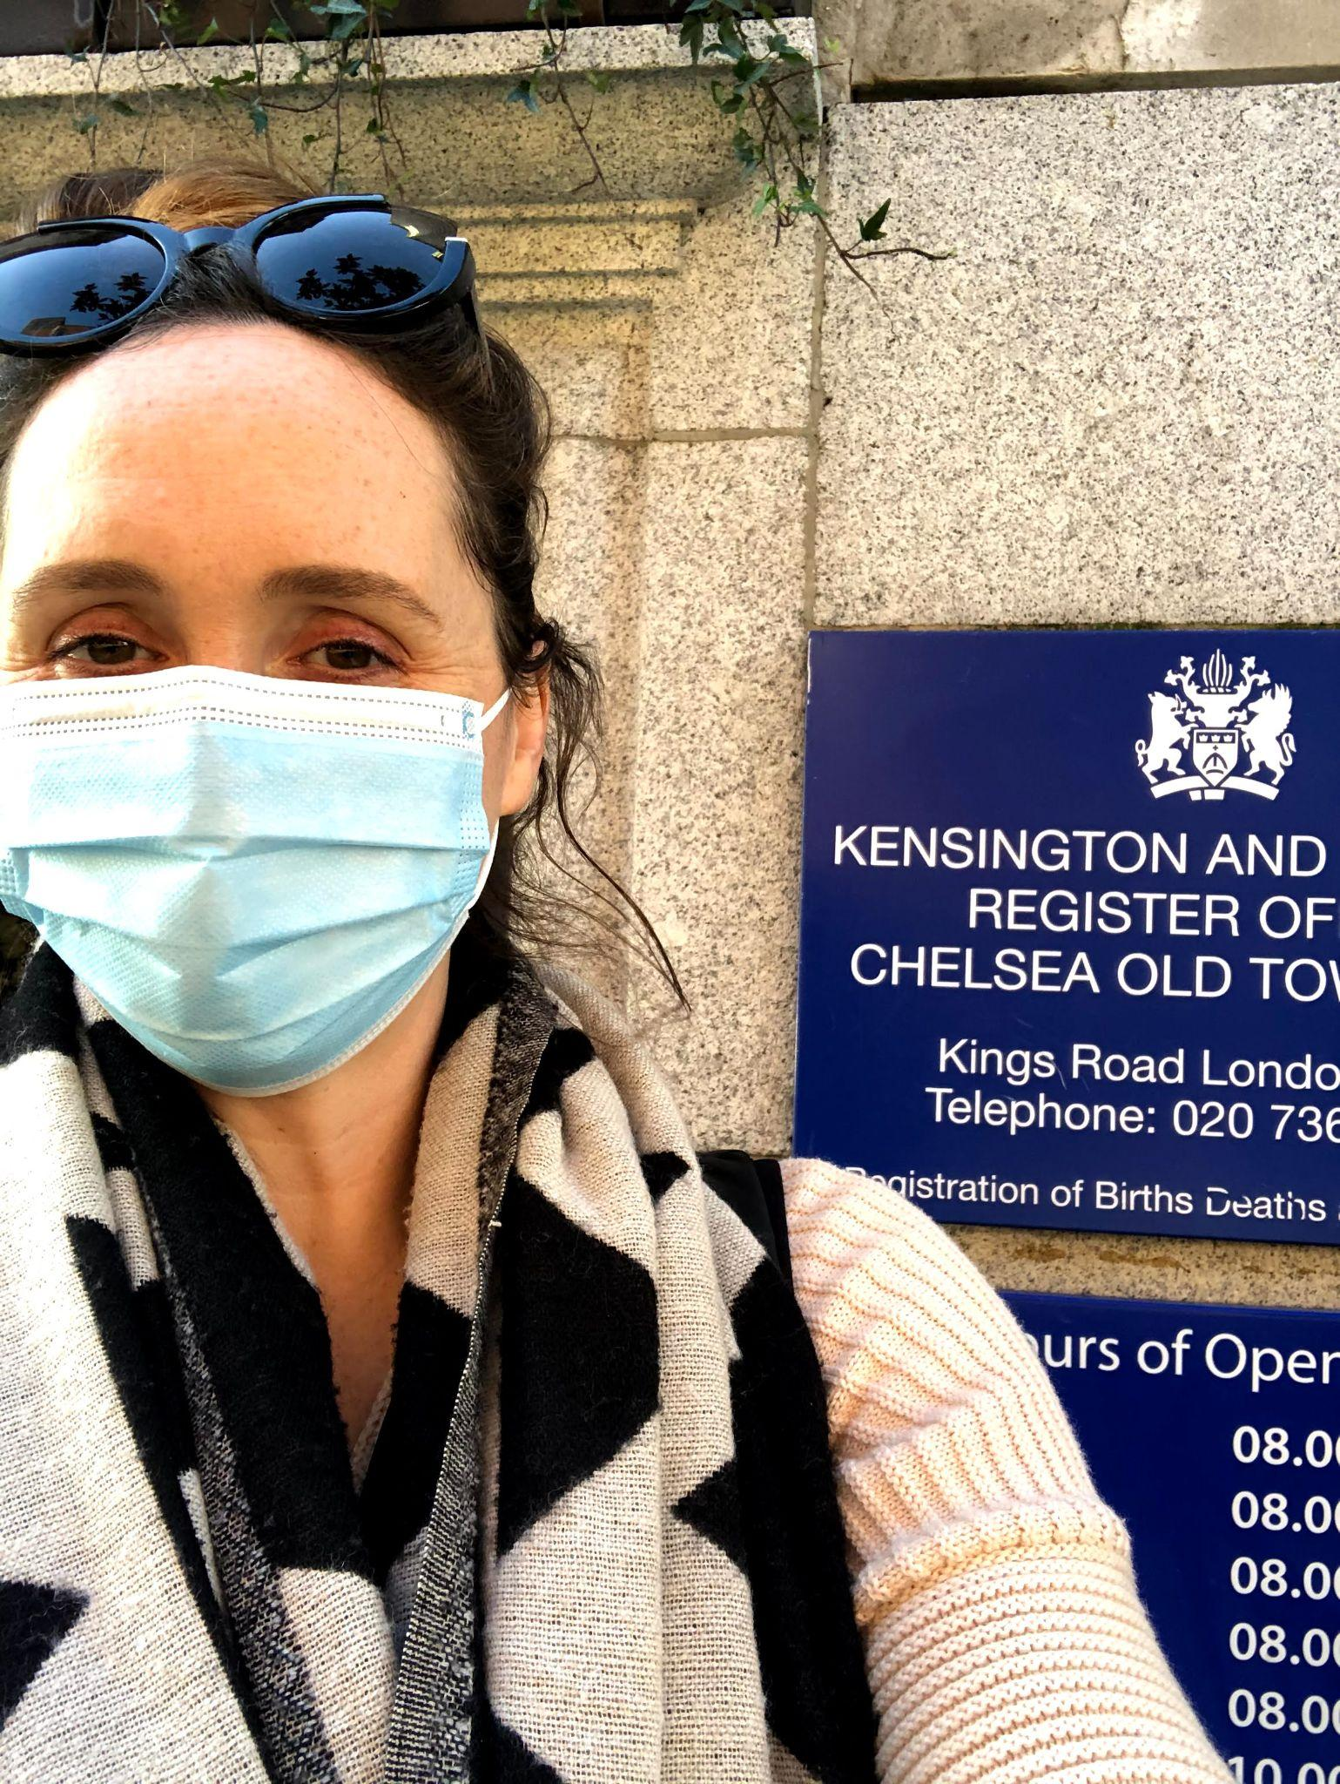
Orlanda and Julian’s Story
“We don’t believe it’s fair that some babies have a Blank Space on their birth certificate where their father’s name should be”.
Registered Charity
No: 1164988

Slide 6
Current Legal Process (England and Wales)
Evidence is submitted to the court
Court is satisfied with the evidence
Court makes declaration of parentage
Completion of the Court Form C63
Common Problems and Barriers
Challenges with Court applications
Court hearings and directions
Multiple Court Hearings
Escalating costs and timelines
Registered Charity
No: 1164988
Notes:
Current Legal process (Family Law Act 1986)
The Court must be satisfied, through examining of all the relevant facts, and assess them in the light of the applicable law.
Before making a declaration of parentage , the court must be satisfied to the civil standard that the evidence establishes either that the named person is or is not the parent.
A declaration of parentage cannot be granted by consent or by default – the exercise of the court must be undertaken and recorded.
Common Problems and Barriers
The Court system can be cumbersome, with the best of intentions, especially for Litigants in Person to have the ability unpack everything the court requires to be considered. There could be several court hearings. Possible reasons for this include –
court application – difficulty in completing the form, understanding what is being asked for
court hearing and directions – i.e. Judge or solicitor not know how to deal with the request, things to be done to get the case ready for the court to formally undertake the examination of facts
there could be 2 or 3 court hearings needed due to lack of knowledge about what might be required.
Multiple court hearings can cause increased and unnecessary upset, escalating costs due to legal fees and extended time delays to obtaining the declaration.

Slide 7
What things need to be considered?
(non-exhaustive – each case turns on the facts);
Witness statements
Notification of deceased estate representative
Interim or final Death Certificate
Find an experienced Solicitor
Childs Birth Certificate
DNA
Patience
Applying directly to a High Court
Registered Charity
No: 1164988
Notes:
Requesting a DNA test between the child and a surviving blood relative of the deceased parent.
Obtaining witness statements from the living parent and/or surviving blood relative(s) depending on the circumstances.
Providing notification of the deceased’s estate’s personal representative to provide their view on the application.
Providing the deceased’s death certificate.
Submitting the existing birth certificate of the child.

Slide 8

Why is this important?
For the child there are a range of associated legal and emotional issues which include;
Personal identity, ancestry and legacy (e.g. establish the truth and fill in gaps about an absent parent)
Genetic and legal relatives and family trees
Medical history and genetic origins
Acquisition of citizenship and nationality (e.g. to support EU citizenship applications or other foreign nationality)
Financial and inheritance rights
Registered Charity
No: 1164988
Notes:
This is not just important for the parents, but it has a lifetime impact on the child
"Every child has the right to be registered at birth, to have a name and nationality, and, as far as possible, to know and be cared for by their parents."
UN Convention of the Rights of the Child

Slide 9
Influencing change
How do we achieve this?
Encourage the number of individuals affected by this matter to;
- Collect DNA evidence of parentage from the deceased father
- sign up to WAY’s mailing list to receive updates and help us gather statistics
Access WAY’s “how to guide” for England and Wales (Scottish guide coming soon)
Increasing wider public knowledge and dissemination of the current system by;
- Lobbying your MP through constructive letter correspondence
(WAY can provide a template)
Share messaging of WAY’s Blank Space campaign via your social media platforms and professional networks
Increase the number of people engaging in the system and the Court which will;
Provide more published court decisions (currently published case law is limited)
Demonstrate this is an issue that affects many individuals and requires legal change.
Registered Charity
No: 1164988
www.widowedandyoung.org.uk/blankspace
Notes:
The law is no longer fit for purpose
Marriage is down and Cohabiting is up since this law was last revised in 1986 which means the number of people this affects has increased dramatically.
Evidence from the 2021 Census showed that adults in 2021 are 44 per cent more likely to have never been married when compared to 1991.
All ages have seen a rise in cohabiting, but it is most striking for couples under 50yrs where 46% of couples are living together rather than getting married.
Way is calling for Parliamentary law reform either by primary or secondary Legislative change
That simplifies the processes and procedures regarding the the registration or children where the unmarried parent is deceased – achieved through Primary Legislation or a Private Members Bill
This was first brought to Parliment in 2016 by MP Stella Creasey, however the change in government resulted in the Minsters recommendations for this to be looked into being lost in the changeover. However, following WAY’s lobbying of MP’s, MP Caroline Voaden and MP Jen Craft brough this issue to Parliament on two separate occasions last year. To date they have had two meetings with the Justice Minister who has directed the Head of the Family Courts to work with WAY to consider how the system can be simplified – we are still wating for them to contact us.

Slide 10
^{Blank Space:}
^{Questions?}
stephanie.patrick@widowedandyoung.org.uk
orlandapanda@hotmail.com
media@widowedandyoung.org.uk
Registered Charity
No: 1164988
www.widowedandyoung.org.uk/blankspace

Slide 11
Blank Space – Birth Certificate equality for co-habiting bereaved parents
Currently the law does not allow a deceased parent's name to be added to a baby's birth certificate if that parent dies before the baby's birth has been registered (this most commonly affects pregnant women).
The relevant law is found at section 55A of the Family Law Act 1986; it currently requires an application to the Family Court for a Declaration of Parentage to be made.
WAY Widowed and Young believes that the law is no longer fit for purpose - Marriage is down and Cohabiting is up since this law was last revised in 1986. The 2021 Census showed that 67% of pregnant women are not married.
“Blank Space" seeks birth certificate equality for cohabiting bereaved parents.
Thurrock MP Jen Craft introduced Blank Space to Parliament for a 10minute rule
bill on 17th June 2025. The next step is to work with the Justice Minister of State
to seek a way to implement change.
In the meantime, scan the QR code to access a “how to" guide which provides guidance about how to navigate the current system, as well as a wide range of information about this issue and explains how you can support with lobbying for change
Registered Charity
No: 1164988
www.widowedandyoung.org.uk/blankspace

