Slide 1
Mortuary Security presentation for Designated Individuals
Martin Goddard – Regulation Manager

Slide 2
Content
Background
HTARIs and themes
Relevant HTA Standards
Most frequent reasons for shortfall
Security measures
Summary

Slide 3
Background
2017 HTA standards revised – including security standards
2021 NHSE issues letter C1435
2021 DHSC issues guidance to review security in Public Mortuaries.
Despite enhanced awareness of security HTA continues to receive HTARIs and discover shortfalls during inspection.

Slide 4
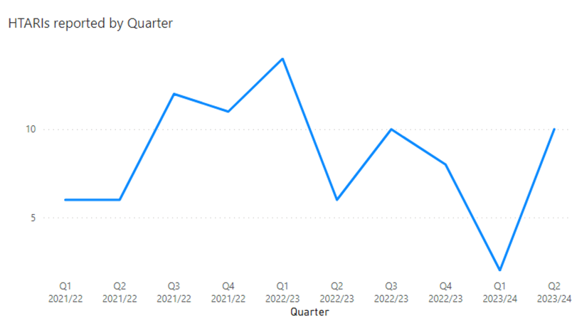
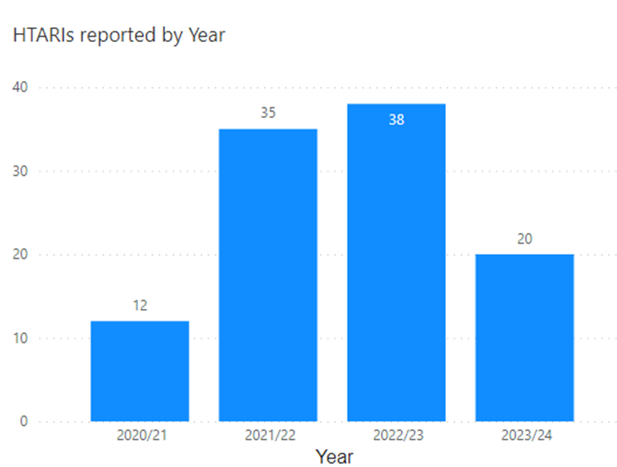
HTARIs
Serious security breach HTARIs reported between Q1 2021 and Q2 2023

Slide 5
HTARI themes
Doors not closed / tailgating
Staff accessing for non work purposes
Insufficient care with close down procedures
Incident
Inappropriate staff having access
Faulty doors / locking / closing mechanisms
Estates depts. Having master keys / swipe and giving these to contractors

Slide 6
Human Tissue Authority Standards
The HTA assesses against 72 standards in the Post Mortem sector. The current standards were introduced in 2017. The standards that relate to security are:
GQ1 (a) Documented policies and SOPs cover all mortuary/laboratory procedures relevant to the licensed activity, take account of relevant Health and Safety legislation and guidance and, where applicable, reflect the guidance from the RCPath.
GQ2 (a) There is a documented schedule of audits.
GQ6 (c) Significant risks, for example to the establishments ability to deliver post mortem services, are incorporated into the trust’s organisational risk register.
PFE1 (d) The premises are secure (for example there is controlled access to the body store area(s) and PM room and the use of CCTV to monitor access).
PFE1 (e) Security arrangements protect against unauthorized access and ensure oversight of visitors and contractors who have a legitimate right of access.

Slide 7
Shortfalls
GQ1 (a) Documented policies and SOPs cover all mortuary/laboratory procedures relevant to the licensed activity, take account of relevant Health and Safety legislation and guidance and, where applicable, reflect the guidance from the RCPath.
Lone working
Alert devices
Out of hours security related procedures for non Mortuary staff

Slide 8
Shortfalls
GQ2 (a) There is a documented schedule of audits.
CCTV vs swipe
CCTV review outside of retention period
Key sign in and out audit
Authorised users

Slide 9
Shortfalls
GQ6 (c) Significant risks, for example to the establishments ability to deliver post mortem services, are incorporated into the trust’s organisational risk register.
Quality and condition of doors and windows
Coverage of CCTV
Coverage of swipe access locks

Slide 10
Shortfalls
PFE1 (d) The premises are secure (for example there is controlled access to the body store area(s) and PM room and the use of CCTV to monitor access).
Damaged doors and locking mechanisms
Lack of locks on viewing room doors
Alarm and door code unchanged
Lack of oversight of keys

Slide 11
Shortfalls
PFE1 (e) Security arrangements protect against unauthorised access and ensure oversight of visitors and contractors who have a legitimate right of access.
Internal areas unlocked out of hours
CCTV not in areas accessed by contractors and staff out of hours

Slide 12
Security Measures
Audit
CCTV
Swipe card system
Established close down procedures
Restricted Access

Slide 13
Summary
HTA require evidence of security measures in place
HTA require evidence of continued monitoring of security
Security is multi-layered
HTARIs can be avoided when establishments have a complete view of security
Designated individuals - are you assured that all persons entering the mortuary are authorised and are entering for a legitimate purpose?

Slide 14



Thank you
@HTA_UK
facebook.com/HumanTissueAuthority
Human Tissue Authority
020 7269 1900 | www.hta.gov.uk
2nd Floor, 2 Redman Place, Stratford, London, E20 1JQ
linkedin.com/company/human-tissue-authority

