Slide 1

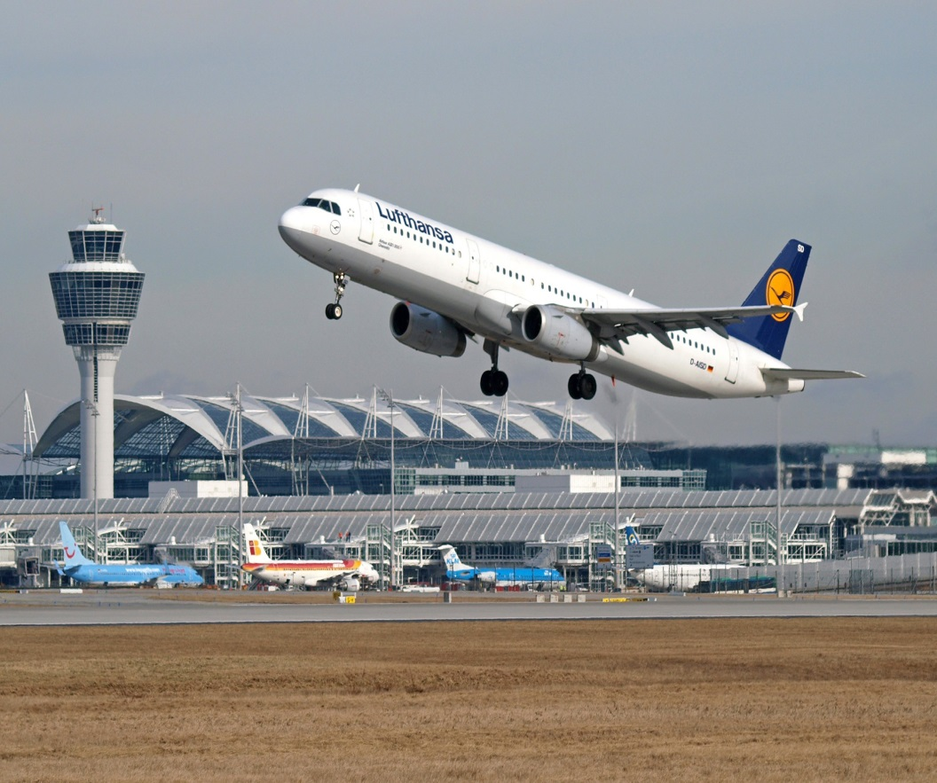

18:00 -18:30 Registration
18:30-19:00 Repatriation Funerals Without Frontiers
19:00-19:15 Break
19:15-20:15 Sudden Death Investigation & Blood Interpretation – Gareth Dineen (This will be an interactive lecture, so be prepared to get out of your seats!!)
London & South East Regional AAPT Network Lecture Evening @ Histopathology Multi-Disciplinary Meeting Room,
4th Floor Bessemer Wing,
Kings College Hospital,
Denmark Hill
London
SE5 9RS
Friday 5th February 2016
London & SE Regional Lead: Lakiesha Ward & Co-Opted Trainee APT Jessica Saunders
Registration forms available from www.aaptuk.org

